Slide 1



American International University-Bangladesh (AIUB)
Autonav: Bluetooth Control Robot Car
Supervised by:
Richard Victor Biswas
Lecturer, Department of EEE, AIUB
Team Members:
Name | ID
Arafat Islam | 19-39377-1
Mohammad Ziaul Haque Abbas | 19-41408-3
Mah-Isha Khan | 20-43829-2
Sadman Salim Nipun | 20-44345-3
Md. Farhan Sadeq | 20-43312-1

Slide 2
Outline
Objectives
Introduction
Research/working method
Description of the work
Results and discussions
Conclusions
Future works

Slide 3
Objectives of the Work
To design and construct a functional robot car that is capable of movement and steering under the control of Motor Controller Module.
To program an Arduino Uno microcontroller board to interpret incoming signals from an Bluetooth Module as commands for the car's motors to move forward, backward, turn left, or turn right.
To establish a wireless Bluetooth connection between a mobile application and the Bluetooth Module that allows the user to control the car's movement via a graphical user interface (GUI) on their smartphone.
To integrate an I2C LCD Display to provide real-time color detection of objects in front of the car.

Slide 4
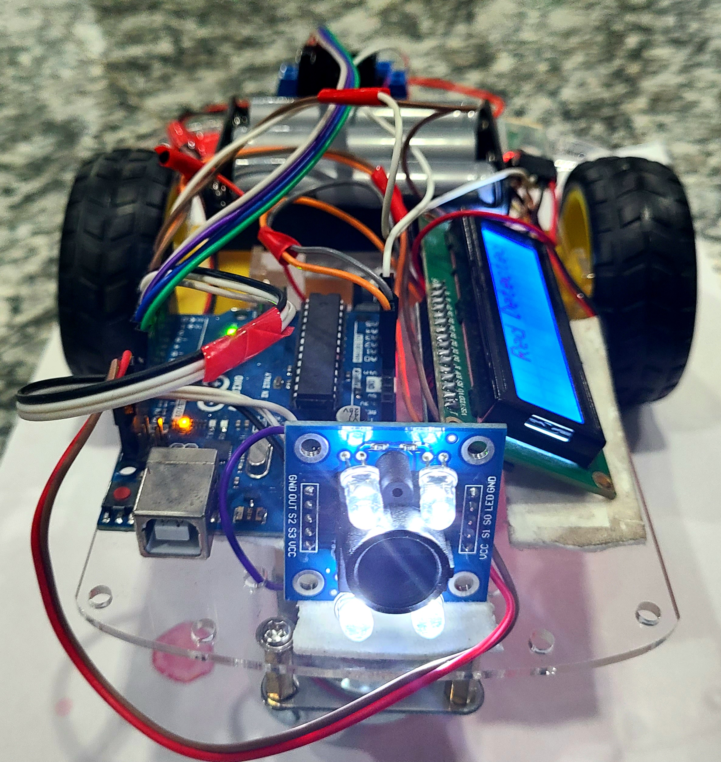
Introduction
The development of robotic vehicles is an area of research that has attracted the attention of many researchers due to its potential applications in various fields. This project aims to develop a Bluetooth-controlled robot car using an Arduino Uno and various components such as a motor controller, battery, and sensors. The car
can be controlled via a mobile application
can detect colors using a color sensor module.
Fig: Robot Car

Slide 5
Background and Motivation
With the increasing demand for remote-controlled robots in various fields, we aimed to design and develop a Bluetooth-controlled robot car using an Arduino Uno and various components.
The use of Bluetooth technology in robotics has gained significant attention due to its ease of use and versatility in various applications.
The robot car can be used for various purposes, including surveillance, exploration, and educational purposes.

Slide 6
What has been done
We have successfully built a robot car using a Robot Car Chassis (Set) 2WD, L298N Dual Motor Controller Module, HC-05 Bluetooth Module Breakout, and other components.
The car can be controlled via Bluetooth using a mobile application
it can track colors using the TCS3200 Color Sensor Module and GY-31 TCS3200 RGB Color Sensor Recognition Module.

Slide 7
Research/Working Method
The robot car is controlled by an Arduino Uno microcontroller, which receives commands via Bluetooth from a mobile application.
The L298N Dual Motor Controller Module is used to control the motors and direction of the robot car.
The TCS3200 Color Sensor Module and GY-31 TCS3200 RGB Color Sensor Recognition Module are used to detect colors.
The I2C LCD Display is used to display the color detected by the robot car.

Slide 8
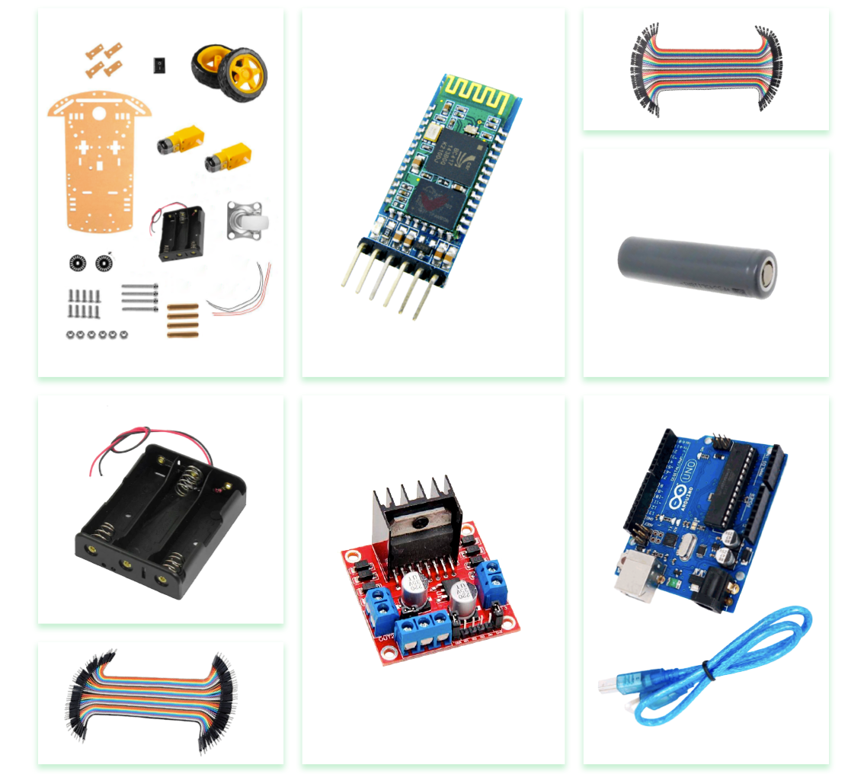
Description of the Work
In this study, we aim to design and construct a Bluetooth-controlled robot car using:
a robot car chassis,
L298N Dual Motor Controller Module,
3.7V 18650 Rechargeable Li-ion Battery,
Arduino Uno
HC-05 Bluetooth Module Breakout
TCS3200 Color Sensor Module
I2C LCD Display (16x2).
Fig: Components

Slide 9
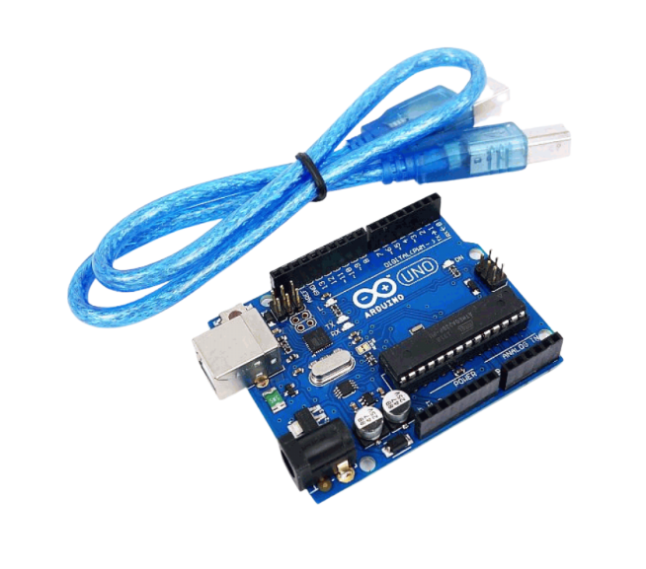
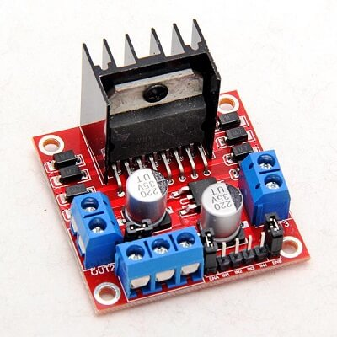
Key Components
The Arduino Uno is an open-source microcontroller board based on the:
Microchip ATmega328P microcontroller,
an 8-bit microcontroller
with 32KB of Flash memory
and 2KB of RAM.
Fig: Arduino
This driver module is made using L298N, a high current, high voltage dual full bridge. It is designed:
to accept standard TTL voltage levels
to drive inductive loads such as DC
capable of driving voltages up to 46V
continuous current up to 2A in each channel.
Fig: Driver module

Slide 10
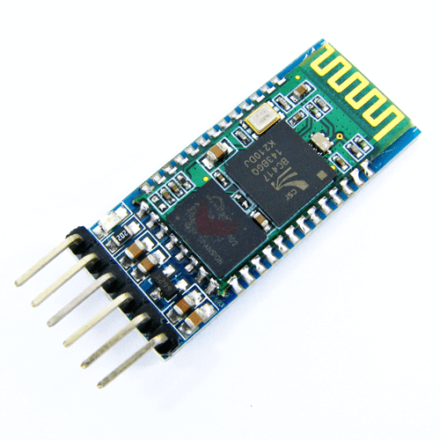
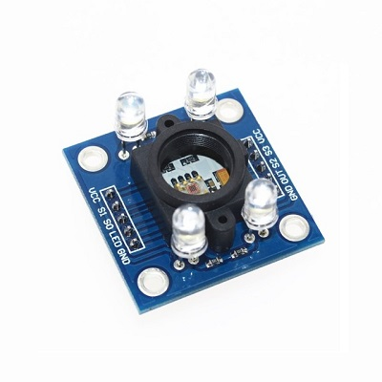
Key Components cont.
The Bluetooth Module Breakout is a wireless serial cable that uses the HC-05 module.
It functions as a serial (RX/TX) pipe
transmission of serial streams from 9600 to 115200bps.
All signal pins on the remote unit are 3V-6V tolerant
Fig: HC-05 module
The TCS3200 chip is used for detecting the color of light that falls on it.
It consists of an 8x8 matrix of photodiodes
The photodiodes are covered with four types of filters, including red, green, blue, and clear.
There are 16 sensors for each color filter
Visible colors can be broken down into three primary colors.
Fig: TCS3200 chip

Slide 11
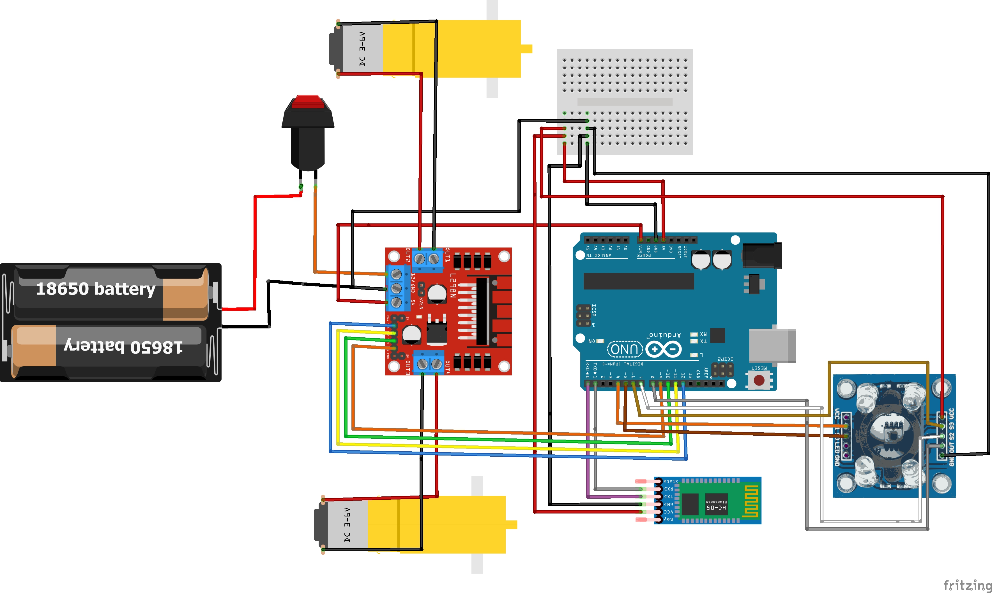
Circuit Diagram
Fig: Circuit Diagram of the Project

Slide 12
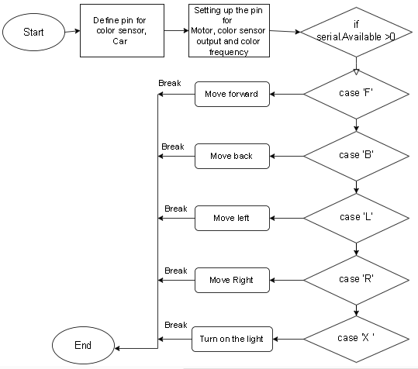
Flowchart

Slide 13
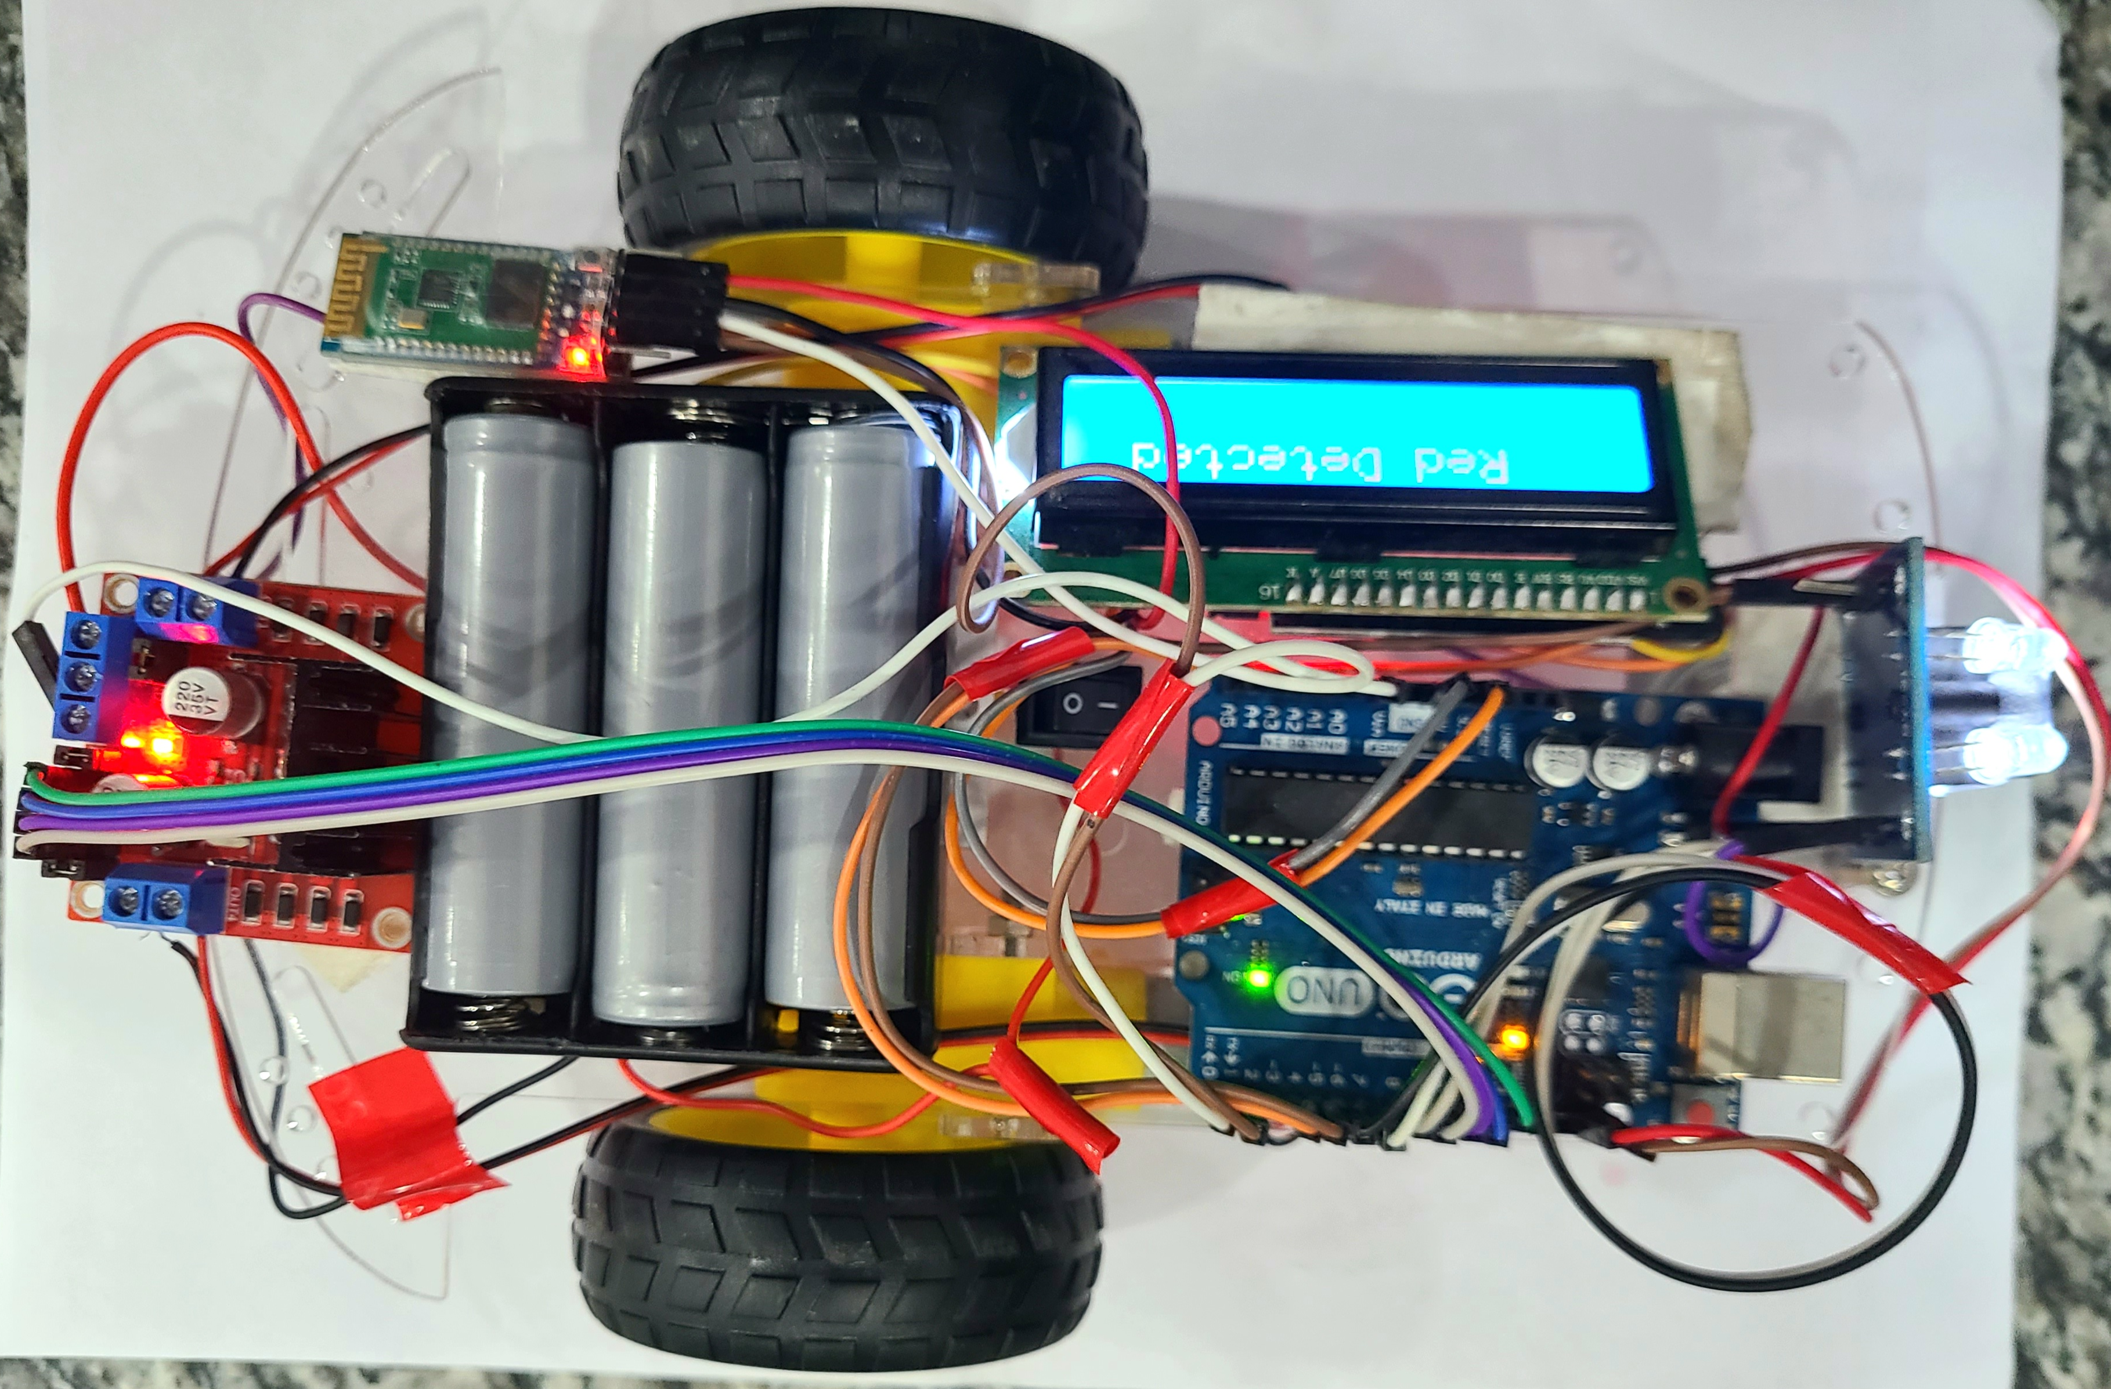
Results and Discussions
Fig: AutoNav Car

Slide 14
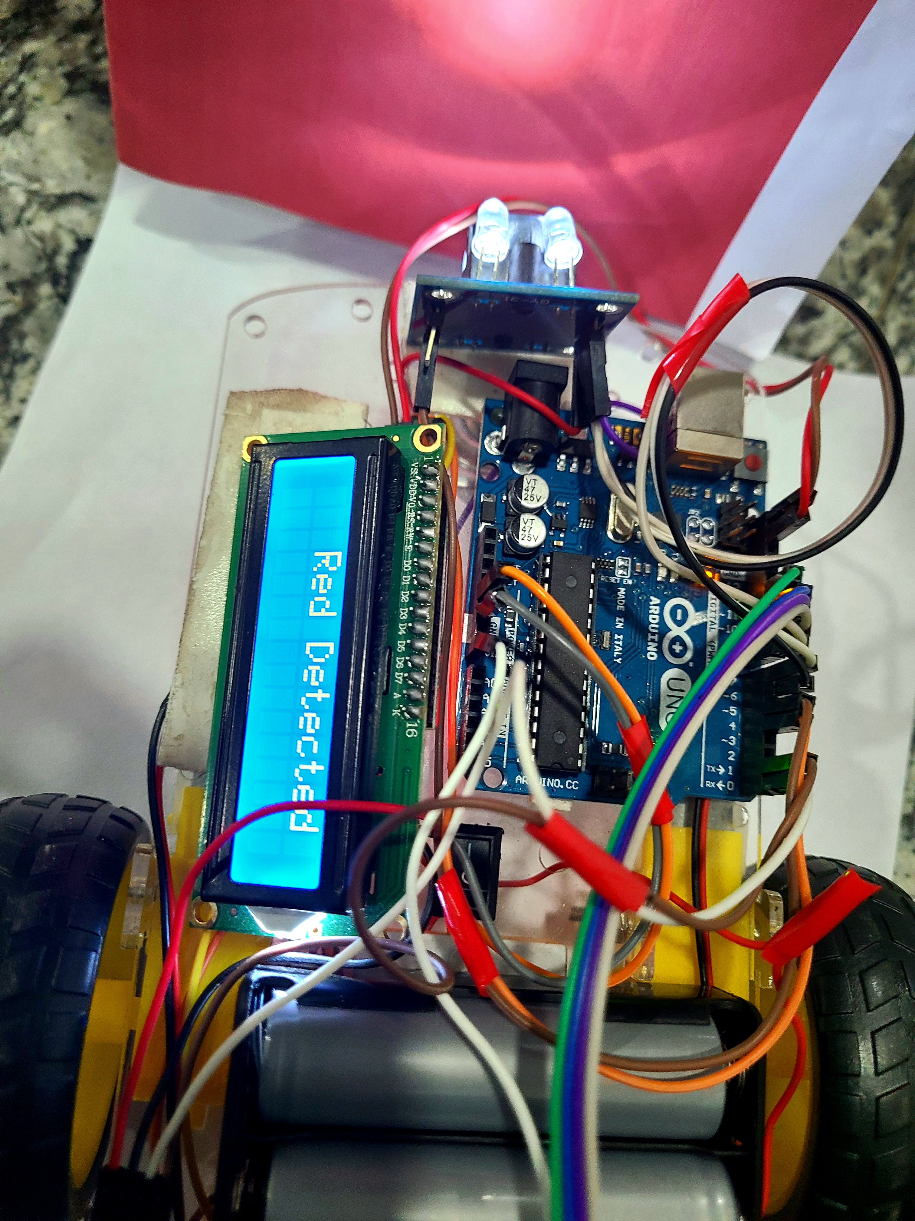
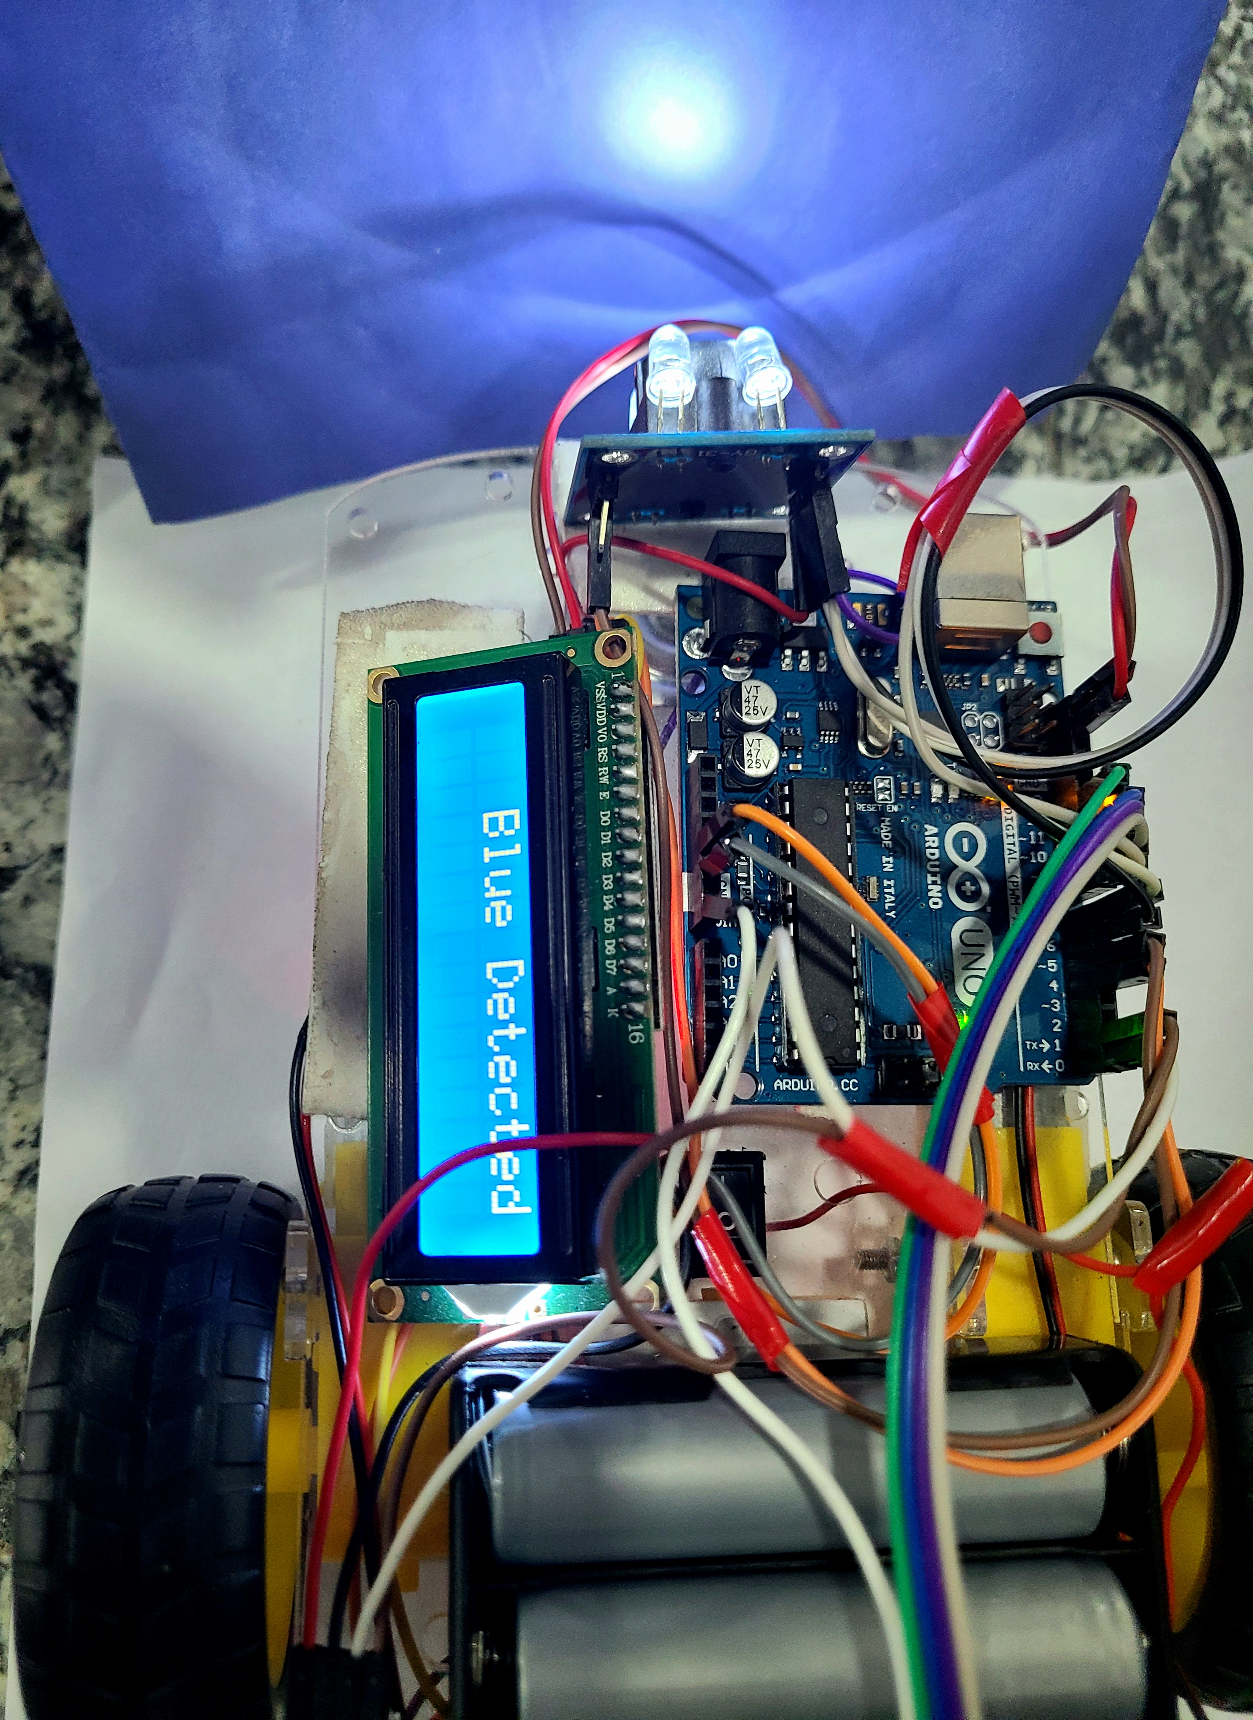
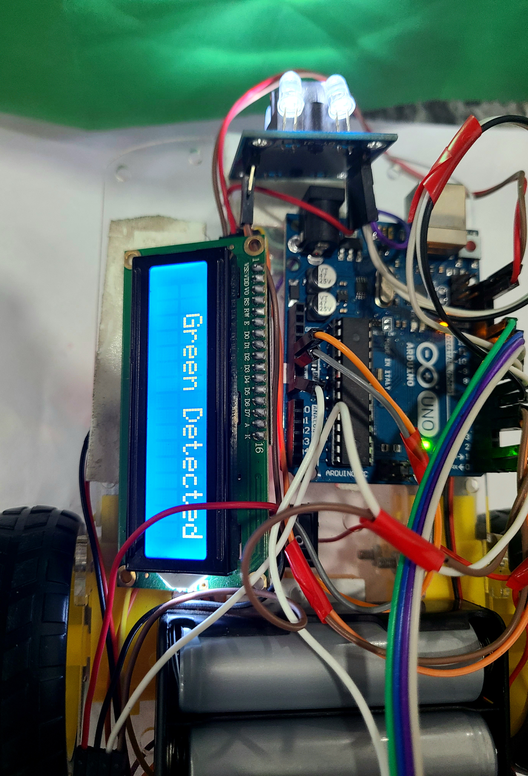
Color Detection
Fig-1: Red color detected
Fig-2: Blue color detected
Fig-3: Green color detected

Slide 15
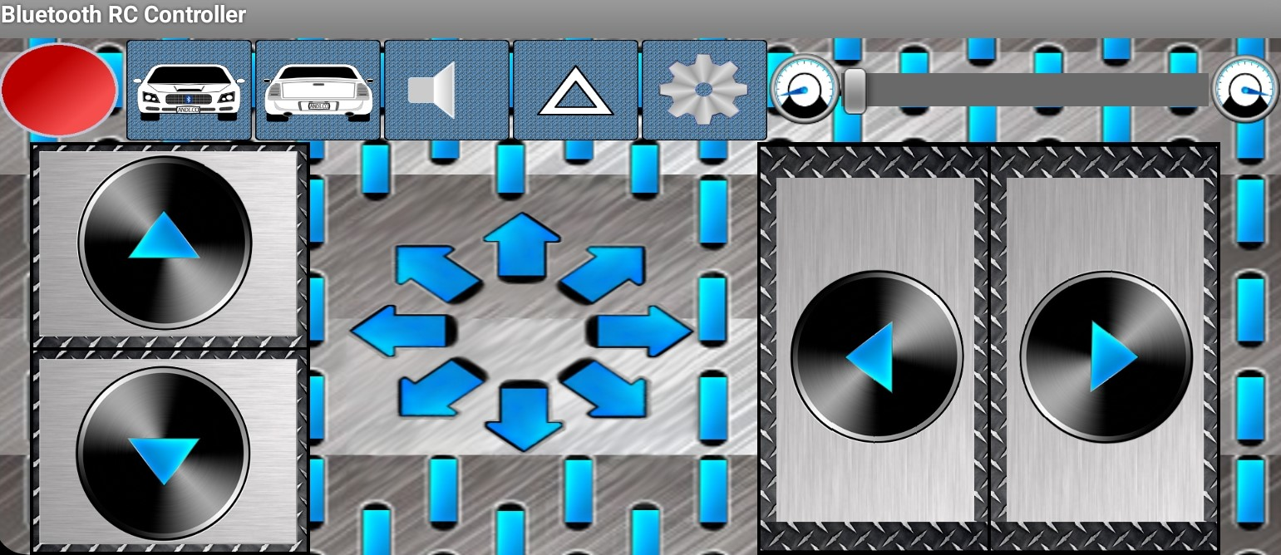
GUI of Mobile Application
Fig: Mobile application to control the car

Slide 16
Conclusion
The development of a Bluetooth controlled robot car was successfully accomplished.
The Bluetooth controlled robot car was successfully designed and implemented using Arduino, L298N motor controller, HC-05 Bluetooth module, and TCS3200 color sensor module.
The car was able to receive commands from a mobile app, avoid obstacles, follow a colored path, and display sensor readings on an LCD screen, demonstrating the effectiveness of Bluetooth technology in robotics.

Slide 17
Future Works
Implementing more advanced sensors for obstacle avoidance and path detection
Integrating machine learning algorithms for improved navigation and control
Developing a more user-friendly mobile application with additional features and functionalities
Building a larger and more robust robot car for outdoor use
Investigating the potential for swarm robotics with multiple Bluetooth controlled cars working together.

Slide 18
Thank You

